Slide 1
Getting started with Azure Infrastructure as a Service (IaaS)
Jessica Deen
Technical Evangelist
Microsoft

Slide 2
MEET THE TEAM
Daniel Egan
Technical Evangelist
Adam Tuliper Technical Evangelist
Kat Harris
Technical Evangelist
Bret Stateham Technical Evangelist
Justine Cocchi
Technical Evangelist
Annie Bubinski Community Evangelist
Jessica Deen Technical Evangelist

Slide 3
MEET OUR MVP/RDs
Christine Flora
Business Solutions
Vishal Saxena
Microsoft Azure
Prabhat Nigam
Office Servers and Services
Mike Vincent
Visual Studio and Dev Tech
Michael Washington
Office Servers and Services
Rob Richardson
Visual Studio and Dev Tech
Dustin Davis
Visual Studio and Dev Tech
Hattan Shobokshi
Visual Studio and Dev Tech
Joe Mayo
Visual Studio and Dev Tech

Slide 5
Why IaaS?

Slide 6
Why Infrastructure as a Service?
Deploy anywhere with Azure as your data center
Run virtually any Windows or Linux based workload
Monitoring, scale, and automation is built in
Flexible hybrid connectivity options
Let’s compare a traditional vs. an Azure deployment

Slide 7




Deploying a Traditional N-Tier Infrastructure
Order Hardware
WEB
APP
SQL
Setup Network Infrastructure
Setup Server Infrastructure
Install and Patch OS
Install and Configure Apps
Multiple Environments?
Repeat steps
Networking Infrastructure
Routers, Switches, Cables, Load Balancing

Slide 8
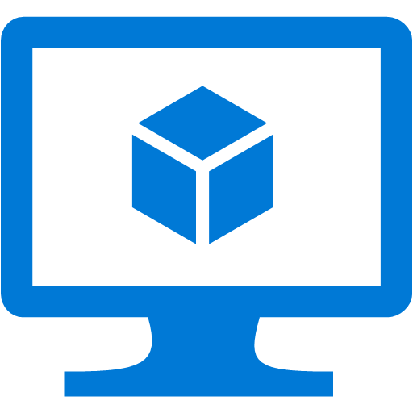

Deploying with Microsoft Azure IaaS Without automation
Configure Virtual Network
WEB
APP
SQL
Deploy VMs and Configure Load Balancer
Patch the OS
Install and Configure Apps
Multiple Environments?
Repeat steps
Networking Infrastructure
Mostly virtualized (IPSEC VPN or Routers)

Slide 9
Deploying with Microsoft Azure IaaS With automation
Identify Repeatable Processes
WEB
APP
SQL
Build Automation (scripts, templates, etc.)
Execute
Multiple Environments?
Change parameter(s) and re-execute
Networking Infrastructure
Mostly virtualized (IPSEC VPN or Routers)

Slide 10
DEMO
Creating an Azure Account

Slide 11
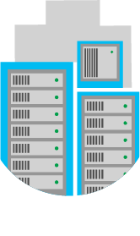
Virtual Machines & Virtual Networks

Slide 12

Azure Virtual Networks
Private network in the cloud
Supports hybrid connectivity to on-premises or other regions
Network traffic segmentation and virtual appliance support
Deploy Virtual Machines, Cloud Service, or App Services
Deploy a virtual network

Slide 13

Azure Storage
Multi-tenant and highly scalable storage system
Automatic local redundancy (3 copies per file)
Enable geo-redundancy for +3 in a remote region
Standard storage or Premium (SSD)
Up to 5,000 IOPS per disk with Premium Storage!

Slide 14
Azure Virtual Machines
Most flexible compute option
Supports Windows and Linux OS’s and most workloads
Create VMs with up to 32 processors and 448 GB of ram
Standard or SSD storage, up to 64TBs for the largest VMs
Built in capabilities for availability and scale

Slide 15
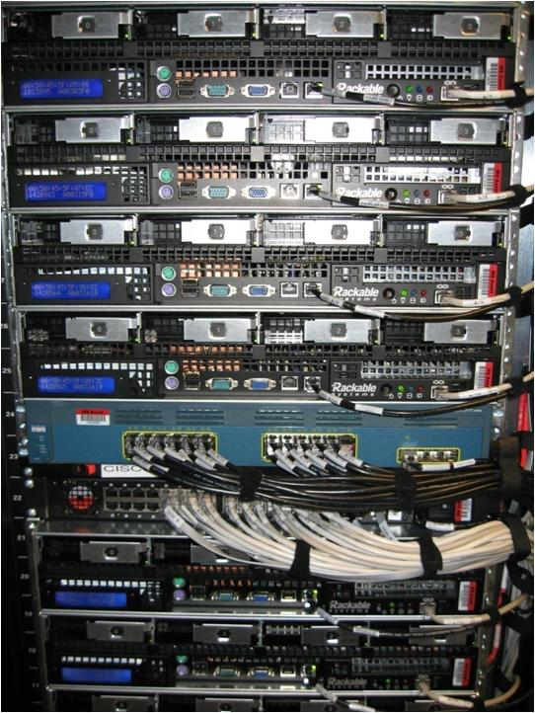
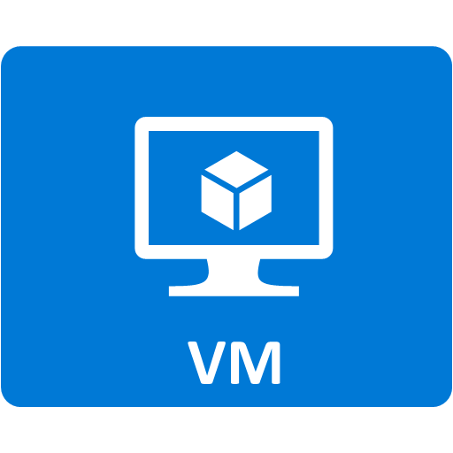
Automatic Physical Redundancy
Availability sets deploy your virtual machines on redundant hardware automatically

Slide 16
Azure Load Balancer
Load balance traffic on a public IP or a private IP (internal)
Support TCP or UDP protocols
Configurable Idle timeout
Health Probe Support
TCP—specify port to probe
HTTP—specify health check page
Flexible Affinity Options
5 tuple (source IP, source port, destination IP, destination port, protocol type)
2 tuple (source IP, destination IP)
3 tuple (source IP, destination IP, protocol)

Slide 17


Auto Scale
Automatically solve the problem of under or over provisioning workloads
Service that starts or stops VMs based on:
A performance metric
Messages in a queue
As part of a schedule
Simple to configure elasticity with stateless workloads
Users
Auto scale
Availability set

Slide 18








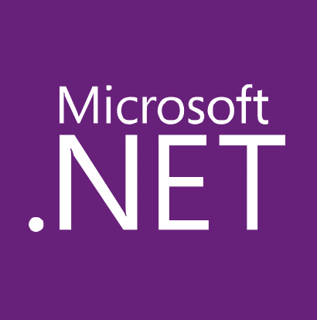


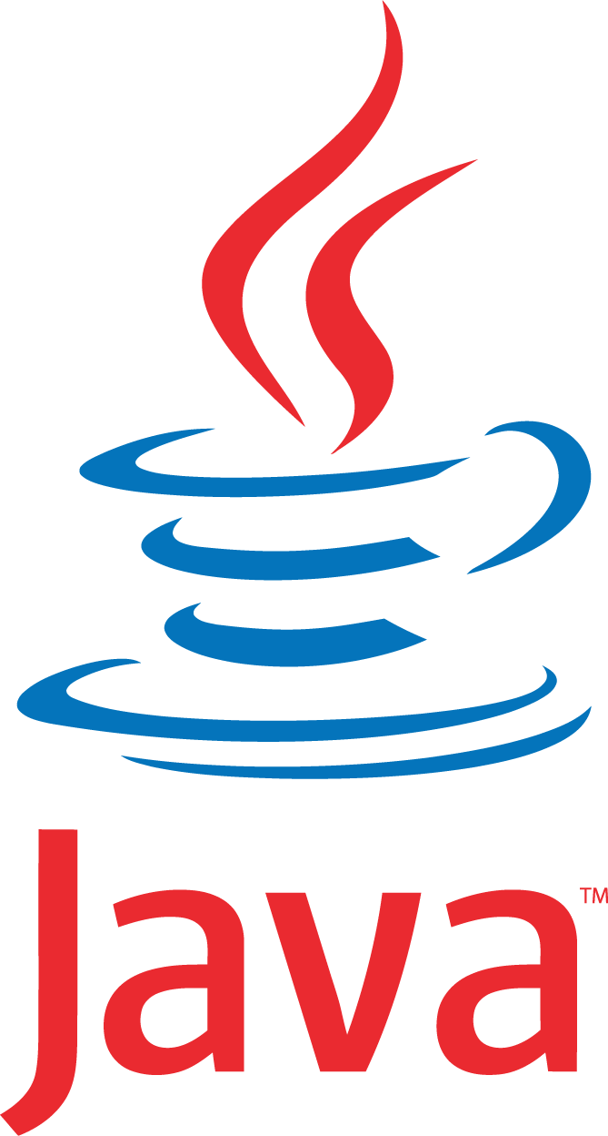








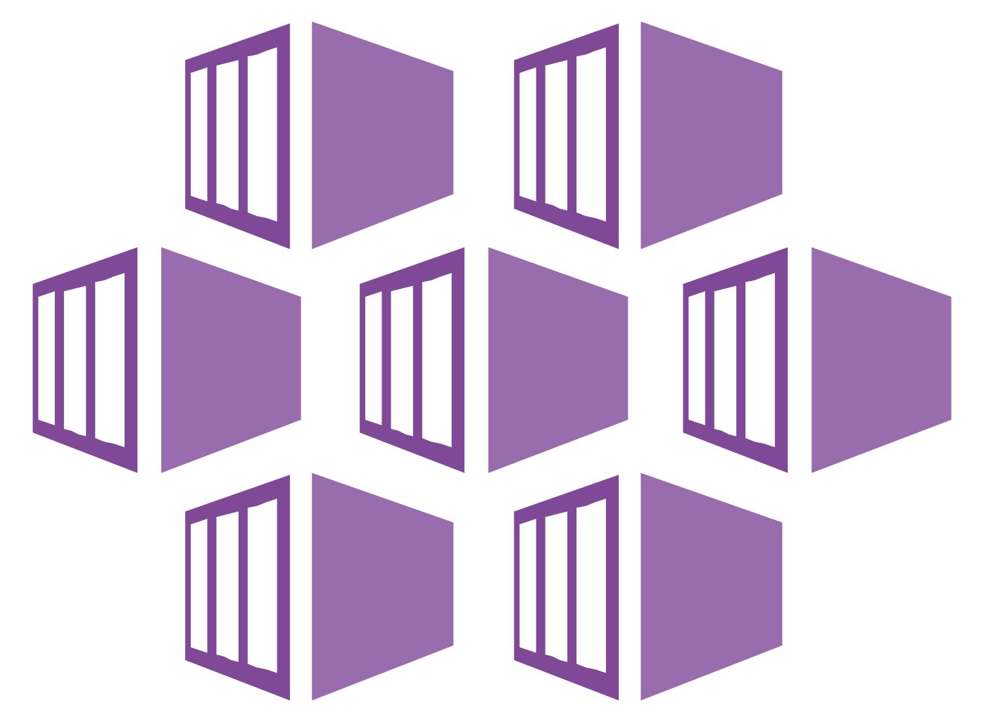
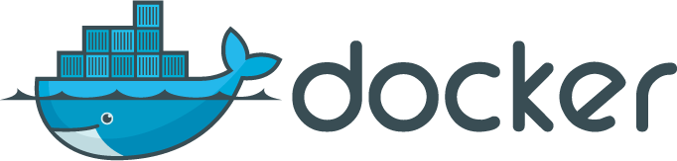



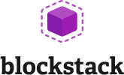



Build and run open source solutions
Any tool, application, framework
Applications
DevOps
Frameworks
Databases & middleware
Containers
Infrastructure
Notes:
We’re heavily invested in open-source technologies and partnerships, as evidenced on this slide. Nearly one in three Azure virtual machines are now running Linux, and we support Linux as a first class citizen.
Why is this important to Microsoft? Because it’s in the best interest of our customers. In fact, over 40% of CIOs are using open source as their primary strategy heading into 2017. We support our customers’ computing, whatever it is and wherever it is.
Finally, we contribute to the open source community as well as build some of our services on open source technology, like HDInsight and Azure Container Service. This also helps us scale to our customers’ needs as we rapidly release cloud solutions.

Slide 19
DEMO
Creating an Azure Virtual Machine using the Azure Marketplace

Slide 20
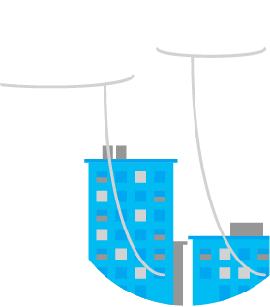
Hybrid Connectivity

Slide 21
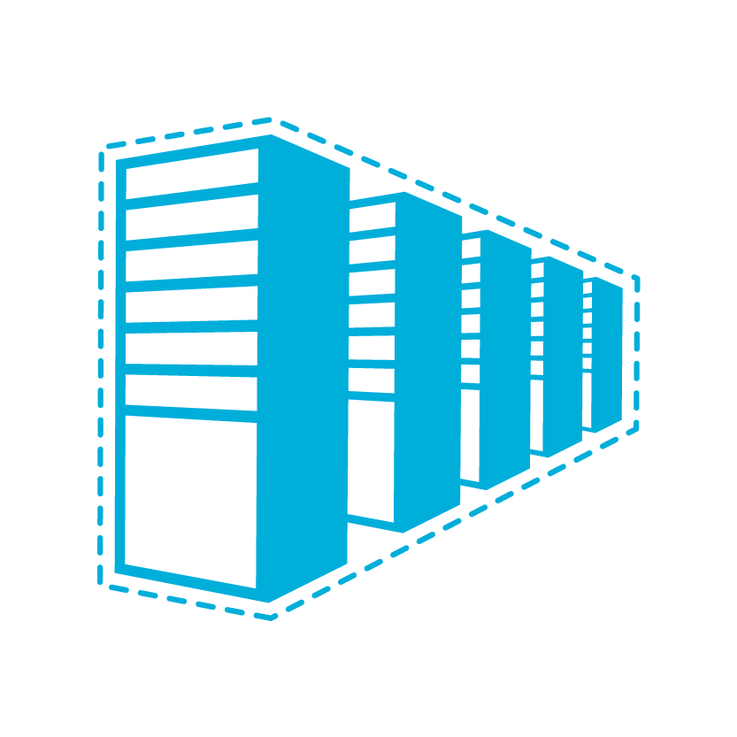
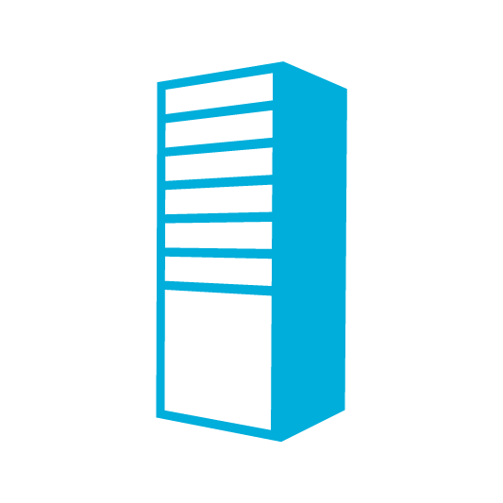

Hybrid Connectivity Options
Cloud
Customer
Segment and workloads
Developers
POC Efforts
Small scale deployments
Connect from anywhere
Secure point-to-site connectivity
SMB, Enterprises
Connect to Azure compute
Secure site-to-site
VPN connectivity
SMB & Enterprises
Mission critical workloads
Backup/DR, media, HPC
Connect to Microsoft services
ExpressRoute private connectivity

Slide 22




Site-to-Site and Point-to-Site
Microsoft Azure West US
Microsoft Azure East US
Virtual Network
Virtual Network
Secure access with Site-to-Site
Secure access with Point-to-Site
Secure access with Point-to-Site
Secure Admin
Secure Dev/Test
Corporate
Network

Slide 23
Azure ExpressRoute
Exchange Provider
Network Service Provider
Microsoft
Microsoft
Public
internet
Customer site 3
Customer site 2
WAN
Public
internet
Customer site
Exchange
Customer site 1
Bandwidth: 200 Mbps to 10 Gbps per circuit
Bandwidth: 10 Mbps to 1 Gbps per circuit
ExpressRoute provides organizations a private, dedicated, high-throughput network connection between Microsoft Azure datacenters and their on-premises IT environment.

Slide 24
Automation and Agility

Slide 25
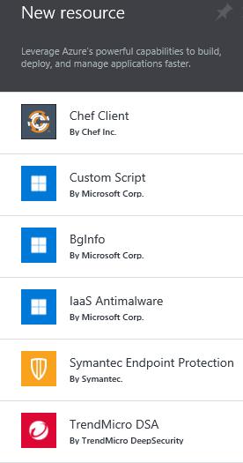
Virtual Machine Extensions
IaaS Anti-malware
Reset password
Docker
Backup
BGInfo
RDMA Drivers
Bash Script PowerShell
PowerShell DSC
Symantec
Trend Micro
Chef
Puppet
SQL IaaS Agent
Visual Studio
Monitoring Partners

Slide 26

Resource Templates
Template
Declarative, model based
Consistent deployment
Source file, checked-in
Parameterized input/output
SQL Server
Web App
DEPENDS ON SQL
SQL CONFIG

Slide 27

Command Line Tools
PowerShell
Windows
Create and manage resources
Execute templates
Cross Plat CLI
Windows, Mac, Linux
Create and manage resources
Execute templates
New-AzureRmResourceGroup $Resource $Location New-AzureRmResourceGroupDeployment -Name $Name -ResourceGroupName $Resource -TemplateUri $TempFile
azure login azure vm quick-create -g $resource –n $vmname ”$location -y Linux -Q canonical:ubuntuserver:14.04.2-LTS:latest -u username -M id_rsa.pub

Slide 28
DEMO
Automating Virtual Machines

Slide 29
More information on IaaS
Azure Virtual Machines documentation
http://azure.microsoft.com/en-us/services/virtual-machines/
Azure Virtual Networks
http://azure.microsoft.com/en-us/documentation/services/virtual-network/
Azure ExpressRoute
http://azure.microsoft.com/en-us/documentation/services/expressroute/
Azure Quick Start Templates
http://azure.microsoft.com/en-us/documentation/templates/
Opsgility Online and Instructor-Led Azure Training
http://www.opsgility.com

Slide 30
MAKE THE MOST OF YOUR EXPERIENCE
Complete the survey for a chance to win a 2TB My Passport Ultra
Survey → aka.ms/SoCalCodeCamp
Visit our booth
Connect with our speakers
Submit Your Session Cards
Fill out a session card to enter a raffle for a Contour+2 Action Camera

Slide 31
What Next?
Learn more about Azure, Cloud, OSS, Linux, PS, etc. http://jessicadeen.com/
Session on Azure Cross Platform Management – Next!

